Slide 1
Navigation group
Progress report –week one.

Slide 2
Overview of previous group work.
From the depository of the GitHub account- https://github.com/jibebe-jkuat/internship2022 . we found the progress report and word documentations that explained their successes and failures of the project.
From these directives we analyzed the codes and the pictures to establish our planned coursework for the period of the attachment.

Slide 3
Concerns and issues arisen.
Usability of previously constructed test robot and code.
Approval of proposed timeline and events scheduled.
Integration of software and used parts with the electrical team.

Slide 4
Things to do
Construction of a robot i.e to showcase functionalities that include:
Obstacle Avoidance.
Navigation system using GPS
AUTOMATION(UNMANNED SYSTEM WITH FUNCTIONAL SENSORS).
[ 2 WEEKS ]

Slide 5
THINGS TO DO.
TESTING AND RECALIBRATION OF THE ROBOT SYSTEMS USING INTERFACED CONTROL SYSTEMS FROM THE ELECTRIC TEAM.
[INCLUSIVE WithiN THE TIME PERIOD OF CONSTRUCTION OF THE ROBOT]

Slide 6
THINGS TO DO.
3. APPLICATION AND IMPLENTATION OF THE NAVIGATION AND OBSTACLE Avoidance SYSTEMS ON TO THE TRACTOR.
[ 3 WEEKS ]

Slide 7
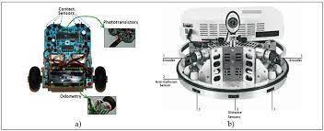
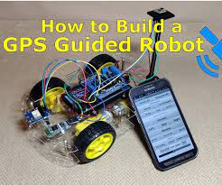
Expected outcome on nav system.

Slide 8
4. Mobile application development
With the interface needed to control the automated electric tractor, we need an app based input control to key in the needed functionalities;
Co-ordinates placing
Speed and direction control through pulse width modulation.
Location placing and path following control.
[ 2 weeks ]

